Slide 1


K.RAMAKRISHNAN COLLEGE OF TECHNOLOGY (AUTONOMOUS), TRICHY
BASIC TEXT EDITOR APPLICATION
PRESENTED BY
2303811720521052-SUBASH R
Guided by
Mrs. Sathya,M.E.,PHD

Slide 2
PRESENTATION OVERVIEW
PROJECT INTRODUCTION
PROJECT OBJECTIVE
PROBLEM STATEMENT
LIBRARIES USED
EXISTING SYSTEM
PROPOSED SYSTEM
BLOCK DIAGRAM
MODULE DESCRIPTION
CONCLUSION AND FUTURE ENHANCEMENT

Slide 3
PROJECT INTRODUCTION
The project, “basic text editor html," aims to develop a Python-based basic text editor that offers essential editing functions, allowing users to create and modify text documents with a user-friendly interface for simple text processing tasks. we’ll add some essential editing functions such as cut , copy , paste , undo and redo.

Slide 4
PROJECT OBJECTIVE
The objective of the Basic Text Editor Application is to provide users with a simple and user-friendly tool for creating and editing text documents. It includes essential features like opening, saving, cutting, copying, pasting, undoing, and redoing text, making it easy for users to perform basic text processing tasks.

Slide 5
PROBLEM STATEMENT
Users need a straightforward and easy-to-use tool to create and edit text documents. Existing text editors can be too complex or lack essential features, making it difficult for users to perform basic text editing tasks efficiently.

Slide 6
LIBRARIES USED
The following Python libraries are utilized in this project to achieve the desired
functionality:
Tkinter: the standard GUI (Graphical User Interface) library for Python. It provides a fast and easy way to create graphical user interfaces.
jQuery: Simplifies JavaScript programming and offers easy DOM manipulation and event handling.
Bootstrap: Provides pre-designed UI components and responsive design features
Font Awesome: Offers a wide range of icons for enhancing the visual appearance of the text editor.

Slide 7
EXISTING SYSTEM
The existing system of basic text editor applications faces limitations in features, usability, compatibility, performance, and security. Users often encounter challenges with simplistic interfaces, limited customization, and the absence of collaborative editing functionalities. Improvements in these areas are necessary to enhance the user experience and functionality of basic text editors.

Slide 8
DISADVANTAGES OF EXISTING SYSTEM
Limited features
Performance limitations
Cross platform inconsistencies
Lack of customization
Security vulnerabilities
Usability issues

Slide 9
PROPOSED SYSTEM
The proposed system aims to enhance basic text editor applications by introducing advanced features like spell check, grammar check, and formatting options. It also focuses on improving usability, expanding file compatibility, optimizing performance, ensuring cross-platform consistency, providing customization options, enhancing security measures, and introducing collaborative editing functionalities. These enhancements are designed to elevate the functionality and user experience of basic text editors.

Slide 10
ADVANTAGES OF PROPOSED SYSTEM
Advanced Features
Improved Usability
Optimised Performance
Cross platform consistency
Enhanced Security
Collaborative Editing

Slide 11
BLOCK DIAGRAM
.
Open the file
Modify the(edit,copy,cut,etc) file
start
Display main window
END
User enter text
Save text to file

Slide 12
Module Description
USER INTERFACE
TEXT EDITING AREA
FILE HANDLING
FORMATTING OPTIONS

Slide 13
USER INTERFACE
This module is responsible for presenting the graphical user interface to the user.
Includes elements such as text input area, menu options, toolbar, and status bar.
Facilitates user interaction and navigation within the application.

Slide 14
TEXT EDITING AREA
Core component where users input, edit, and manipulate text.
Supports functionalities such as typing, selecting, copying, cutting, pasting, undoing, and redoing text operations..
Displays the content of the text document being edited.

Slide 15
FILE HANDLING
Manages file-related operations, such as opening, saving, and managing text documents.
Provides functionality to create new documents, open existing ones from local storage, and save edited documents back to storage.
Supports various file formats for compatibility with different applications.

Slide 16
FORMATTING OPTIONS
Provides basic formatting options to customize the appearance of text.
Includes functionalities such as font selection, text size adjustment, bold, italic, and underline.
Enhances the visual presentation of text within the editor.

Slide 17
CONCLUSION AND FUTURE ENHANCEMENT
In conclusion, the basic text editor application provides essential text editing capabilities within a user-friendly interface, serving as a valuable tool for everyday tasks. Moving forward, future enhancements could include integrating spell check and grammar check functionalities, adding search and replace options, implementing customizable themes, integrating with cloud storage services for enhanced accessibility, introducing collaborative editing features, implementing version control functionality, and incorporating accessibility features to ensure usability for all users. These enhancements aim to elevate the functionality and versatility of the text editor, meeting the evolving needs of users in text processing and document editing tasks..

Slide 18
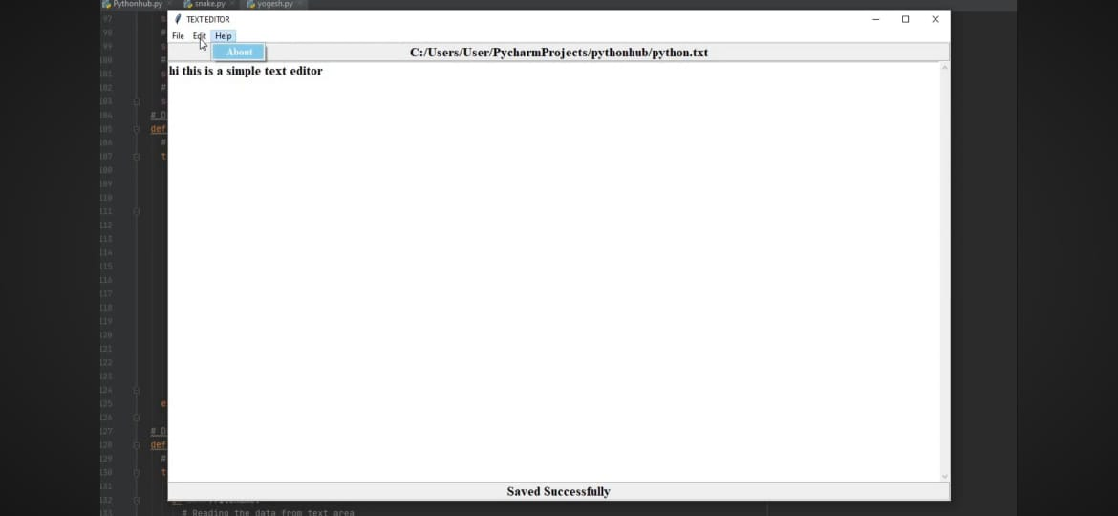
SCREENSHOT

Slide 19
THANK YOU

